Slide 1
Project Demand Forecasting Of Cars
Author:- Pavan Wanjari

Slide 2
Meaning of Demand Forecasting
Demand forecasting is the process of using predictive analysis of historical data to estimate and predict customers' future demand for a product or service. It involves anticipating the demand for the product and services of an organization in future under a set of uncontrollable and competitive forces.
Accurate demand forecasting is essential for a firm to enable it to get the required quantities at the right time and arrange well in advance for various inputs.

Slide 3
Objective
The main objective of the problem is to develop the machine learning approach to forecast the demand of car rentals on an hourly basis.

Slide 4
Problem Statement
ABC is a car rental company based out of Bangalore. It rents cars for both in and out stations at affordable prices. The users can rent different types of cars like Sedans, Hatchbacks, SUVs and MUVs, Minivans and so on.
In recent times, the demand for cars is on the rise. As a result, the company would like to tackle the problem of supply and demand. The ultimate goal of the company is to strike the balance between the supply and demand in order to meet the user expectations.
The company has collected the details of each rental. Based on the past data, the company would like to forecast the demand of car rentals on an hourly basis.

Slide 5
Content
Data Pipeline
Data Description
Exploratory Data Analysis
Data Pre-processing
Model Building
Model Evaluation
Conclusion

Slide 6
Data Pipeline
Exploratory Data Analysis(EDA): In EDA we see data visualization
Data Pre-processing: In this part we have clean data like removing outliers.
Model Building: This is a final part, here we build various models, check error rates and select best performing model for our project.

Slide 7
Data Dictionary
Variable | Description
date | Date (yyyy-mm-dd)
hour | Hour of the day
demand | No. of car rentals in a hour
Training set:
train.csv contains the hourly demand of car rentals from August 2018 to February 2021.
Test set
test.csv contains only 2 variables: date and hour. You need to predict the hourly demand of car rentals for the next 1 year
i.e. from March 2021 to March 2022.
Variable | Description
date | Date (yyyy-mm-dd)
hour | Hour of the day

Slide 8
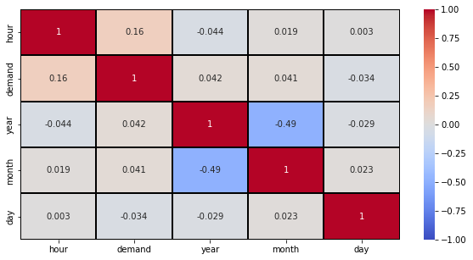
EDA Correlation
Check the correlation of variables with each other.

Slide 9
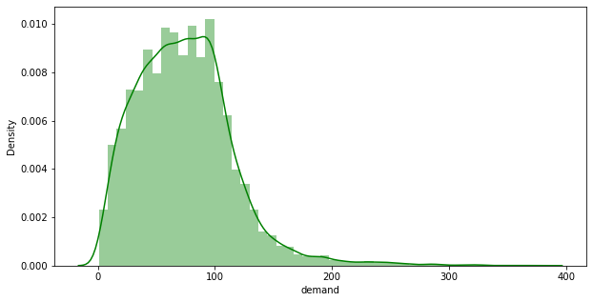
Distribution
Distribution of demand of cars show in this figure

Slide 10
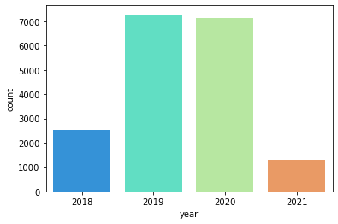
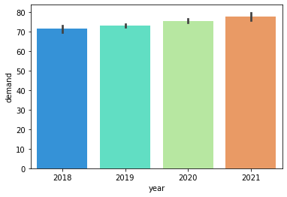
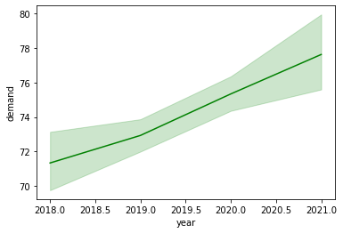
Yearly Performance
Year | Count
2019 | 7286
2020 | 7145
2018 | 2511
2021 | 1305
We Can see here Demand of cars is increasing Year by Year

Slide 11
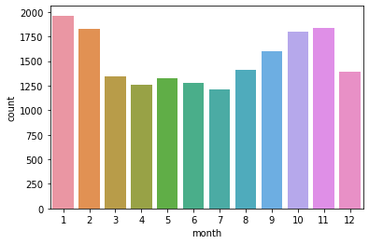
Demand Per Month
Here we can see Demand of car counts per month of years 2018-2021.
Demand of cars required per month in the range of 80-100.
In Jan, Feb and Nov. has more demand of Cars.
Months | Counts
January | 1963
February | 1826
March | 1346
April | 1258
May | 1321
June | 1281
July | 1214
August | 1406
September | 1603
October | 1798
November | 1837
December | 1394

Slide 12
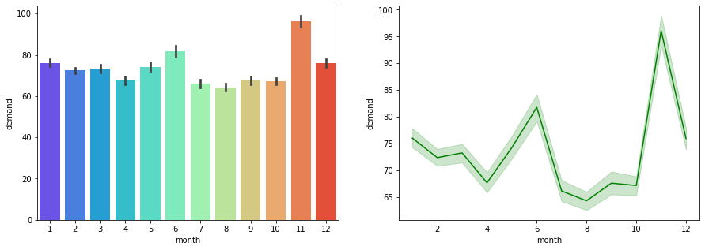
Demand Per Month
High Demand of cars in winter season.
Also we can see the range 85-95.

Slide 13
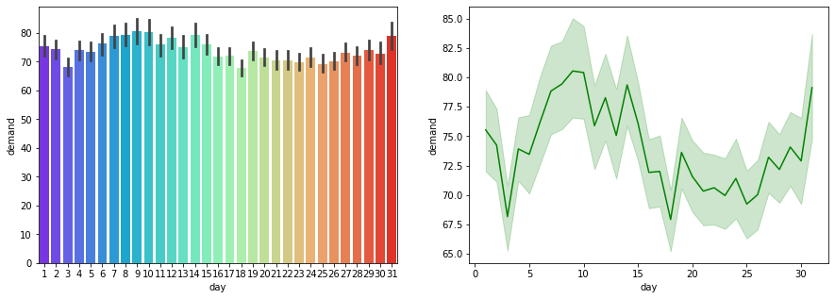
Cars Required Per Day
Every day Demand of cars between the range of 70-80 cars.
For giving the good service the car rental company needs 70-80 cars every day.

Slide 14
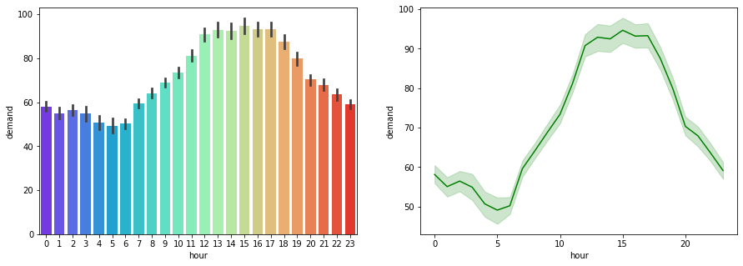
Cars required by time(Hours)
In the morning time less demand of cars.
In afternoon from 12pm – 6pm more requirement of cars.

Slide 15
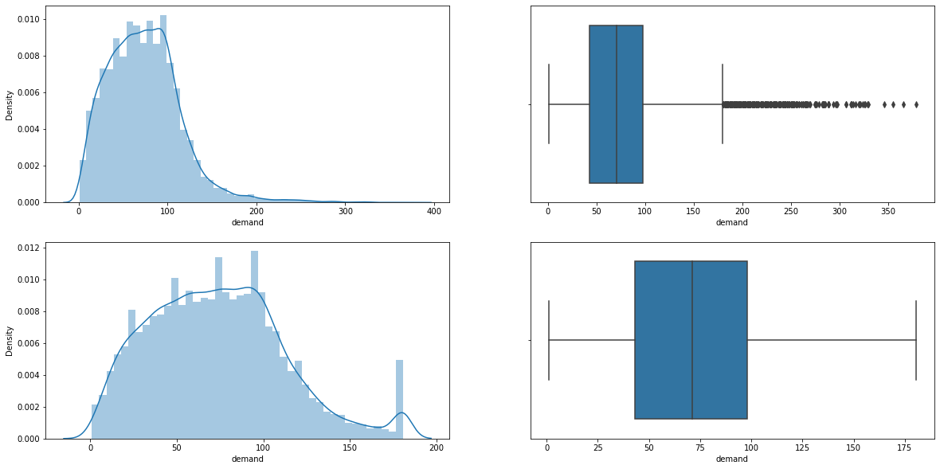
Feature Engineering
Removing Outliers from Demand for getting better result by use of IQR method.

Slide 16
Models Performed
Linear Regression
Decision Tree Regressor
Random Forest Regressor
Support Vector Machines
Ada Boost Regressor
Gradient Boost Regressor
XG Boost Regressor

Slide 17
Model Evaluation
Model Name | MAE | MSE | RMSE | R2-score
XG Boost Regressor | 27.725000 | 1101.817000 | 33.193630 | 0.271000
Random Forest | 27.920000 | 1127.518000 | 33.578542 | 0.254000
Gredient Boost Regressor | 28.198000 | 1145.010000 | 33.837996 | 0.243000
Ada Boost Regressor | 29.221000 | 1249.031000 | 35.341634 | 0.174000
Linear Regression | 30.789000 | 1445.269000 | 38.016692 | 0.044000
Support Vector Machines | 31.056000 | 1475.749000 | 38.415473 | 0.024000
Decision Tree | 36.119000 | 2014.593000 | 44.884223 | -0.333000

Slide 18
Model Validation & Selection
Observation:-
In XG Boost Regressor we get R2-score is 0.27, RMSE score is 33.19.
In Random Forest Regressor we get R2-score is 0.25, RMSE score is 33.57.
In Gradient Boost Regressor we get R2-score is 0.430, RMSE score is 33.83.
Selection :-
We select XG Boost Regressor is best performing model for our Project.

Slide 19
Conclusion
The result shows that XG Boost regressor and Random Forest Regressor is best model used for Demand Forecasting of Cars in Car rental company.
The performance of model MSE, RMSE shows lower and R2 – score has higher value for XG Boost and Random Forest Regressor.
So we can use either XG Boost or Random Forest Regressor for Prediction.

Slide 20
Approach For Future Business
We have to noticed that every year demand of cars increasing. The company would like to tackle this problem so company needs to balance between supply and Demand of cars.
By the use of Historical data we see the demand of cars is in range of 70-80 and every year its increasing.
So now for next year company needs cars in the range of 90-100.

Slide 21
THANK YOU !!

